Slide 1
Introduction to User Interface Design
Lecturer: Ngo Huy Bien
Software Engineering Department
Faculty of Information Technology
VNUHCM - University of Science
Ho Chi Minh City, Vietnam
nhbien@fit.hcmus.edu.vn

Slide 2

Objectives
To communicate in user interface design field.

Slide 3

Contents
Terms
Usability Goals and Measures.
Guidelines, Principles and Theories.

Slide 4

References
Ben Shneiderman et al. (2018). Designing the User Interface - Strategies for Effective Human. Pearson.
William Lidwell, Kritina Holden and Jill Butler (2010). Universal Principles of Design. Rockport Publishers.

Slide 5
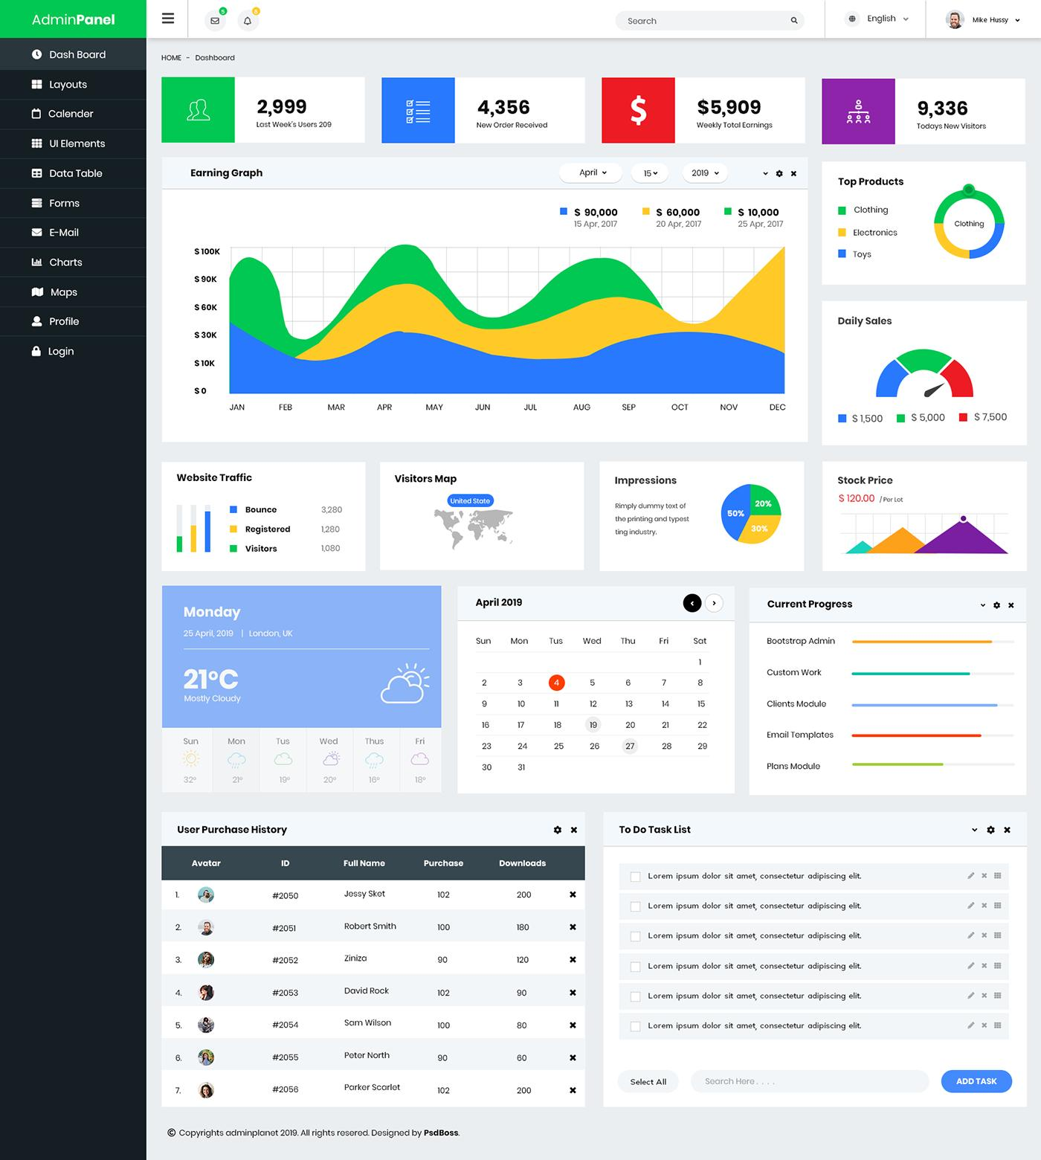
Web UI
A web UI is a full user interface delivered via a web browser, typically representing an entire application or system.

Slide 6
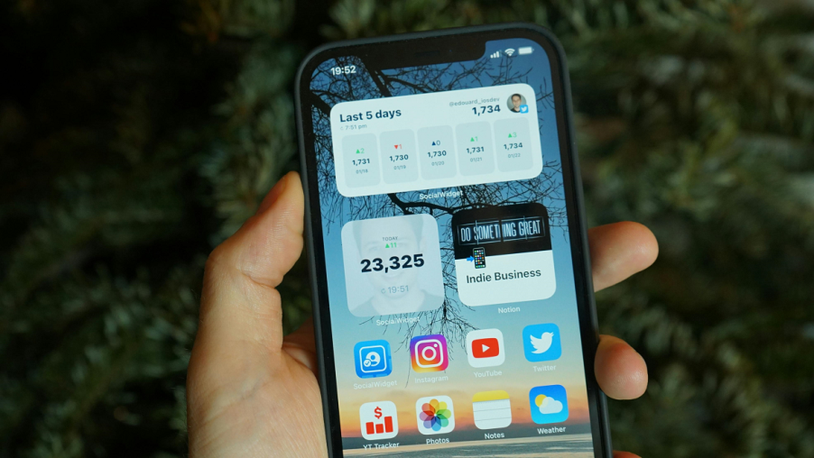
Widget UI
A widget UI is a reusable, self-contained UI component that can be embedded inside larger interfaces, including but not limited to web UIs.
Examples
Weather widget on phone home screen
Chat support bubble on a website
Stripe payment widget
Dashboard metric card

Slide 7
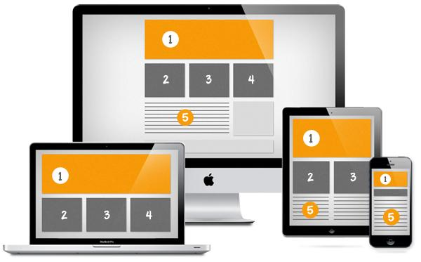
Widget UIs and Larger UI

Slide 8


Slide 9
Usability Goals and Measures [1]
Time to learn. How long does it take for typical members of the user community to learn how to use the actions relevant to a set of tasks?
Speed of performance. How long does it take to carry out the benchmark tasks?
Rate of errors by users. How many and what kinds of errors do people make in carrying out the benchmark tasks?
Retention over time. How well do users maintain their know ledge after an hour, a day, or a week?
Subjective satisfaction. How much did users like using various aspects of the interface?

Slide 10
Empirical Evidence and Theories
Guidelines. Low- level focused advice about good practices and cautions against dangers.
Principles. Middle -level strategies or rules to analyze and compare design alternatives.
Theories. High-level widely applicable frameworks to draw on during design and evaluation as well as to support communication and teaching.

Slide 11
Guidelines: Navigating the Interface
Standardize task sequences. Allow users to perform tasks in the same sequence and manner across similar conditions.
Use unique and descriptive headings. Use headings that are distinct from one another and conceptually related to the content they describe.

Slide 12
Guidelines: Organizing the Display
Consistency of data display. During the design process, the terminology, abbreviations, formats, colors, capitalization, and so on should all be standardized and controlled by use of a dictionary of these items.
Efficient information assimilation by the user. The format should be familiar to the operator and should be related to the tasks required to be performed with the data.
Minimal memory load on the user. Users should not be required to remember information from one screen for use on another screen. Tasks should be arranged such that completion occurs with few actions, minimizing the chance of forgetting to perform a step.

Slide 13
Guidelines: Getting the User's Attention
Marking. Underline the item, enclose it in a box, point to it with an arrow, or use an indicator such as an asterisk, bullet, dash, plus sign, or X.
Size. Use up to four sizes, with larger sizes attracting more attention.
Choice of fonts. Use up to three fonts.
Color. Use up to four standard colors, with additional colors reserved for occasional use.
Audio. Use soft tones for regular positive feedback and harsh sounds for rare emergency conditions.

Slide 14
Principles: Determine users' skill levels
Novice or first-time users. True novice users-for example, grandparents sending their first e-mail to a grandchild-are assumed to know little of the task or interface concepts.
Knowledgeable intermittent users. Many people are knowledgeable but intermittent users of a variety of systems-for example, corporate managers using word processors to create templates for travel reimbursements.
Expert frequent users. Expert "power" users are thoroughly familiar with the task and interface concepts and seek to get their work done quickly. They demand rapid response times, brief and non-distracting feedback, and the shortcuts to carry out actions with just a few keystrokes or selections.

Slide 15
Principles: Identify the tasks
High-level task actions can be decomposed into multiple middle-level task actions, which can be further refined into atomic actions that users execute with a single command, menu selection, and so on.
Relative frequency of use is one of the bases for making architectural design decisions. For example, in a word processor:
Frequent actions might be performed by special keys, such as the four cursor arrows, Insert, and Delete.
Less frequent actions might be performed by a single letter plus the Ctrl key, or by a selection from a pull-down menu-examples include underscore, bold, or save.
Infrequent actions or complex actions might require going through a sequence of menu selections.

Slide 16
Principles: Choose an interaction style
Direct manipulation: When a clever designer can create a visual representation of the world of action, the users' tasks can be greatly simplified, because direct manipulation of familiar objects is possible.
Menu selection: In menu-selection systems, users read a list of items, select the one most appropriate to their task, and observe the effect.
Form fill-in: Users see a display of related fields, move a cursor among the fields, and enter data where desired.
Command language: Users learn the syntax and can often express complex possibilities rapidly, without having to read distracting prompts.
Natural language: Speech recognition can be helpful with familiar phrases.
Blending several interaction styles may be appropriate when the required tasks and users are diverse.

Slide 17
Principles: Prevent errors
As much as possible, design the system such that users cannot make serious errors; for example, gray-out menu items that are not appropriate and do not allow alphabetic characters in numeric entry fields.
If a user makes an error, the interface should detect the error and offer simple, constructive, and specific instructions for recovery.

Slide 18
Design-by-Levels Theories
One approach to developing descriptive theories is to separate concepts according to levels.
An appealing and easily comprehensible design-by-levels theory for interfaces is the four-level conceptual, semantic, syntactic, and lexical theory (Foley et al., 1995):
The conceptual level is the user's "mental model" of the interactive system.
The semantic level describes the meanings conveyed by the user's input and by the computer's output display. For example, deleting an object in a drawing program could be accomplished by undoing a recent action or by invoking a delete-object action.
The syntactic level defines how the user actions that convey semantics are assembled into complete sentences that instruct the computer to perform certain tasks. For example, the delete-files action could be invoked by a multiple object selection, followed by a keystroke, followed by a confirmation.
The lexical level deals with device dependencies and with the precise mechanisms by which users specify the syntax (for example, a function key or a mouse double-click within 200 milliseconds).

Slide 19
Stages-of-Action Theories
Another approach to forming explanatory theories is to portray the stages of action that users go through in using interactive products such as information appliances, web interfaces, or mobile devices (e.g., music players).
Norman (2013) offers seven stages of action, arranged in a cyclic pattern, as an explanatory theory of human-computer interaction:
Forming the goal
Forming the intention
Specifying the action
Executing the action
Perceiving the system state
Interpreting the system state
Evaluating the outcome

Slide 20
Consistency Theories
The argument for consistency is that if terminology for objects and actions is orderly and describable by a few rules, users will be able to learn and retain them easily.
Consistent | Inconsistent A | Inconsistent B
delete/ insert table | delete/ insert table | delete/ insert table
delete/ insert column | remove/ add column | remove/insert column
delete/ insert row | destroy/ create row | delete/insert row
delete/ insert border | erase/ draw border | delete/insert border

Slide 21

Thank You & See You Again

